Slide 1
ENSEMBLE CLASSIFIER
Dr. Md. Manowarul Islam
Associate Professor, CSE, JnU

Slide 2
Wisdom of Crowd
“If you aggregate many different opinions from a diverse group of people, you are much more likely to arrive at the best opinion than if you just listen to one specialist.”

Slide 3
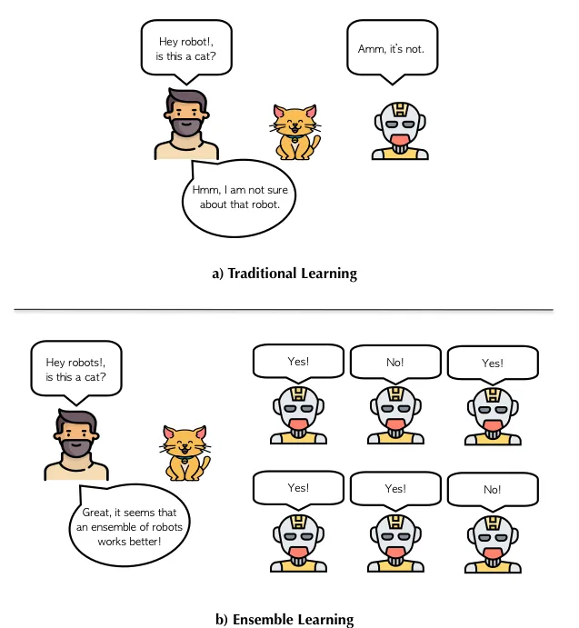
INTRODUCTION

Slide 4
Different Classifiers (1)
Different Classifiers
Conduct classification on a same set of class labels
May use different input or have different parameters
May produce different output for a certain example
Learning Different Classifiers
Use different training examples
Use different features

Slide 5
Different Classifiers (2)
Performance
Each of the classifiers is not perfect
Complementary
Examples which are not correctly classified by one classifier may be correctly classified by the other classifiers
Potential Improvements?
Utilize the complementary property

Slide 6
Ensembles of Classifiers
Idea
Combine the classifiers to improve the performance
Ensembles of Classifiers
Combine the classification results from different classifiers to produce the final output
Unweighted voting
Weighted voting

Slide 7


Example: Weather Forecast
Reality
1
2
3
4
5
Combine
X
X
X
X
X
X
X
X
X
X
X
X
X

Slide 8
Ensemble Learning
Ensemble Learning
Relatively later field in machine learning
Achieve state-of-the-art performance
Central Issues in Ensemble Learning
How to create classifiers with complementary performances
How to conduct voting

Slide 9
Strong and Weak Learners
Strong Learner
Take labeled data for training
Produce a classifier which can be arbitrarily accurate
Objective of machine learning
Weak Learner
Take labeled data for training
Produce a classifier which is more accurate than random guessing

Slide 10
INTRODUCTION
An ensemble classifier is a machine learning technique that combines the predictions of multiple base classifiers to make a final prediction.
Combination of multiple and diverse model
Attempts to make performance of a model better by improving accuracy
Strategically constructed to solve problems like classification or regression

Slide 11
ENSEMBLE METHODS
Bagging (Bootstrap Aggregating)
Boosting
Stacking

Slide 12
BAGGING
Bagging is a homogeneous weak learners’ (DT/SVM) model that learns from each other independently in parallel and combines them for determining the model average
Bagging is classified into two parts –
bootstrapping
aggregation

Slide 13
BAGGING
Bagging is a homogeneous weak learners’ model that learns from each other independently in parallel and combines them for determining the model average
Data Sampling: Creating multiple subsets of the training dataset using bootstrap sampling (random sampling with replacement).
Model Training: raining a separate model on each subset of the data.
Aggregation: Combining the predictions from all individual models (averaged for regression or majority voting for classification) to produce the final output.

Slide 14
BAGGING
Bagging is a homogeneous weak learners’ model that learns from each other independently in parallel and combines them for determining the model average

Slide 15
BAGGING
Bootstrapping
is a sampling technique where samples are derived from the whole population (set) using the replacement procedure.
The sampling with replacement method helps make the selection procedure randomized.
The base learning algorithm is run on the samples to complete the procedure.
Weak Learner
Aggregation in bagging is done to incorporate all possible outcomes of the prediction and randomize the outcome.

Slide 16
Bagging
Create ensembles by “bootstrap aggregation”, i.e., repeatedly randomly resampling the training data (Brieman, 1996).
Bootstrap: draw N items from X with replacement
Bagging
Train M learners on M bootstrap samples
Combine outputs by voting (e.g., majority vote)
Decreases error by decreasing the variance in the results due to unstable learners, algorithms (like decision trees and neural networks) whose output can change dramatically when the training data is slightly changed.

Slide 17
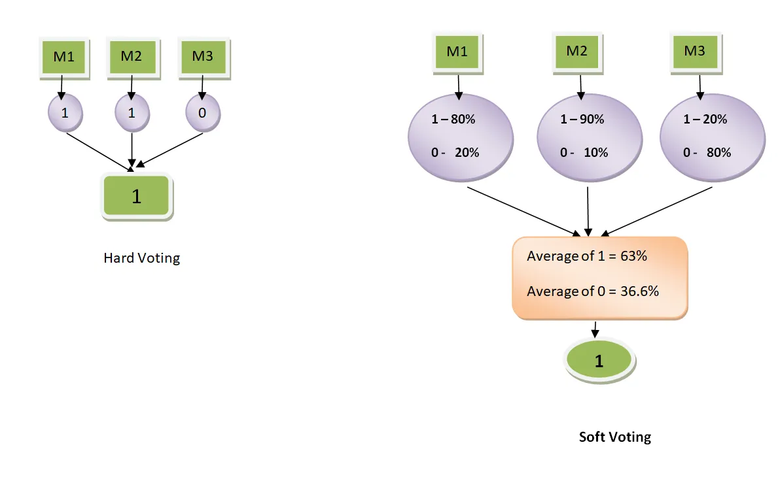
Hard vs. Soft voting

Slide 18
Bagging - Aggregate Bootstrapping
Given a standard training set D of size n
For i = 1 .. M
Draw a sample of size n*<n from D uniformly and with replacement
Learn classifier C_{i}
Final classifier is a vote of C₁ .. C_{M}
Increases classifier stability/reduces variance

Slide 19
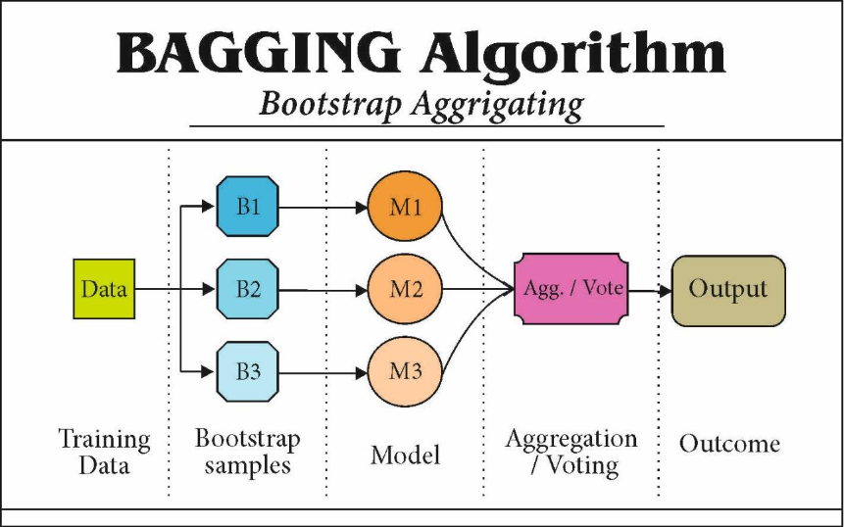
BAGGING

Slide 20
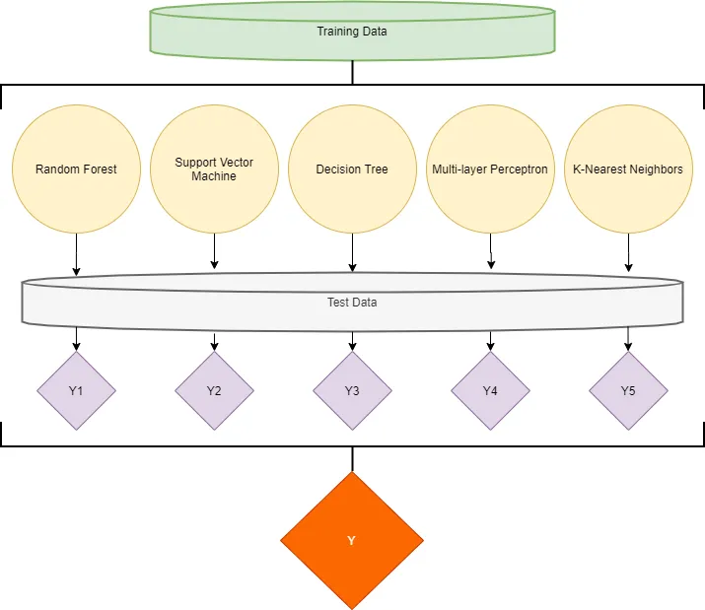
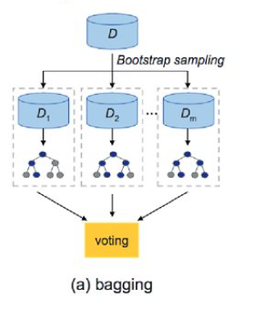
Many popular ensemble algorithms are based on this approach, including:
Random Forest
Extra Trees

Slide 21
Bagging (Bootstrap AGGregatING)
Bootstrap sampling: sampling with replacement
Build classifier on each bootstrap sample
Probability of a training instance being selected in a bootstrap sample is:
1 – (1 - 1/n)^{n} (n: number of training instances)
~0.632 when n is large

Slide 22
Bagging Algorithm

Slide 23
Bagging Example
Consider 1-dimensional data set:
Classifier is a decision stump (decision tree of size 1)
Decision rule: x ≤ k versus x > k
Split point k is chosen based on entropy
x ≤ k
True
False
y_{left}
y_{right}

Slide 24
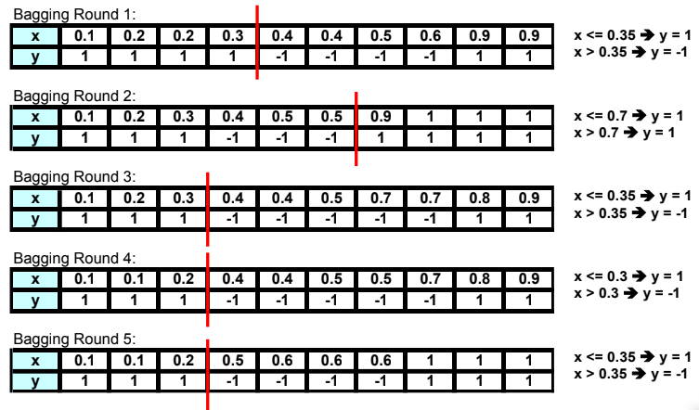
BAGGING EXAMPLE

Slide 25
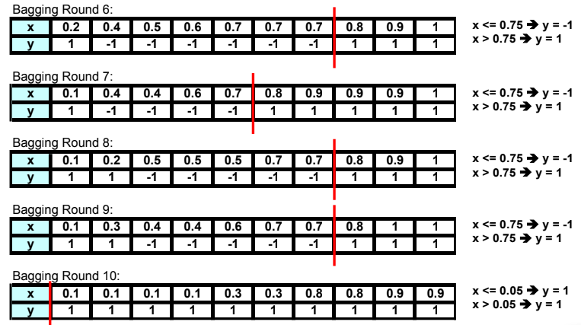
BAGGING EXAMPLE

Slide 26
Bagging Example
Summary of Trained Decision Stumps:

Slide 27
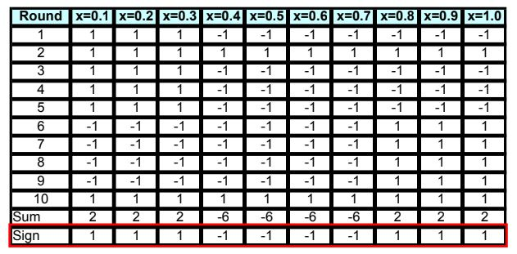
BAGGING EXAMPLE
Use majority vote (sign of sum of predictions) to determine class of ensemble classifier

Slide 28
https://www.educative.io/answers/ensemble-methods-in-python-averaging
https://medium.com/analytics-vidhya/simple-weighted-average-ensemble-machine-learning-777824852426

Slide 29
Random Forest
Random forest is a versatile machine learning algorithm developed by Leo Breiman and Adele Cutler. It leverages an ensemble of multiple decision trees to generate predictions or classifications. By combining the outputs of these trees, the random forest algorithm delivers a consolidated and more accurate result.
Random forest is an ensemble model using bagging as the ensemble method and decision tree as the individual model.
Let’s take a closer look at the magic🔮 of the randomness:

Slide 30
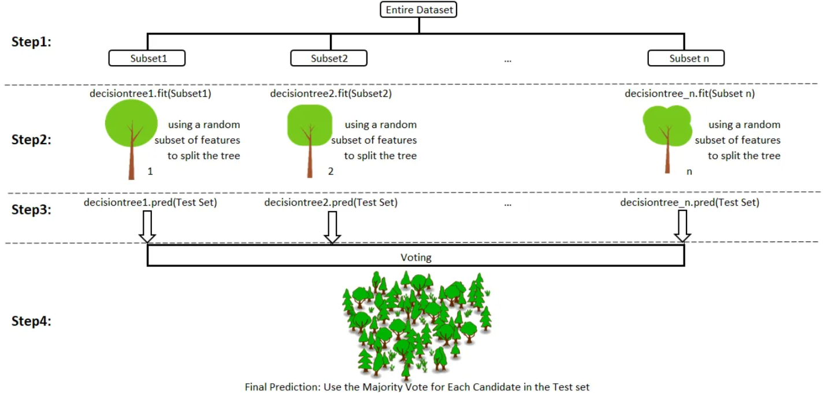
Random Forest

Slide 31
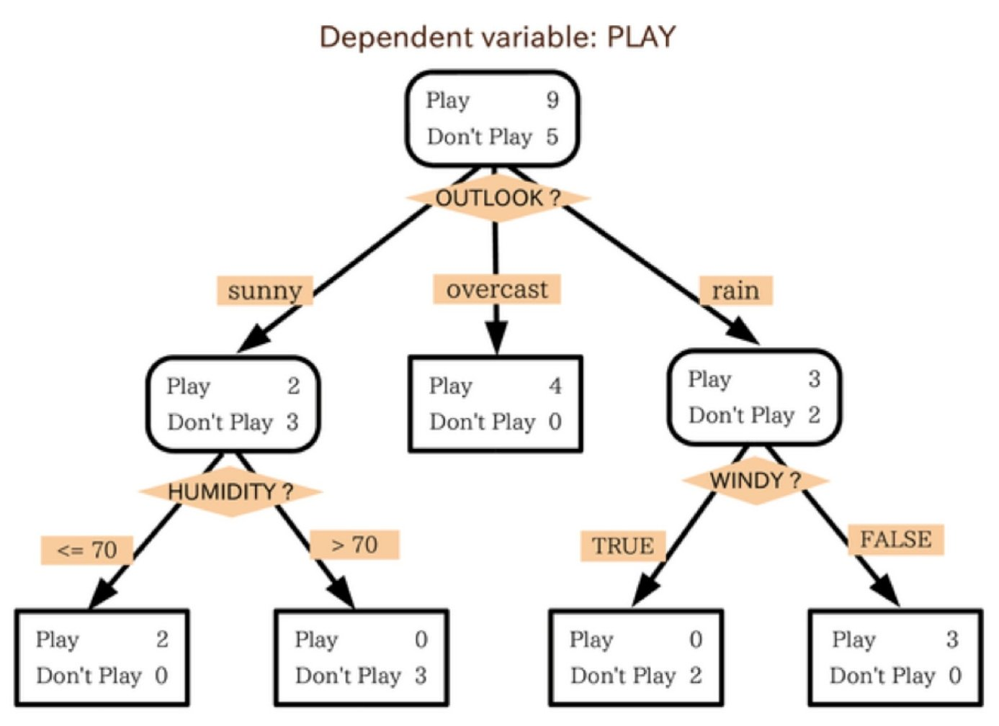
Trees and Forests
In this example, the tree advises us, based upon weather conditions, whether to play ball. For example, if the outlook is sunny and the humidity is less than or equal to 70, then it’s probably OK to play.

Slide 32
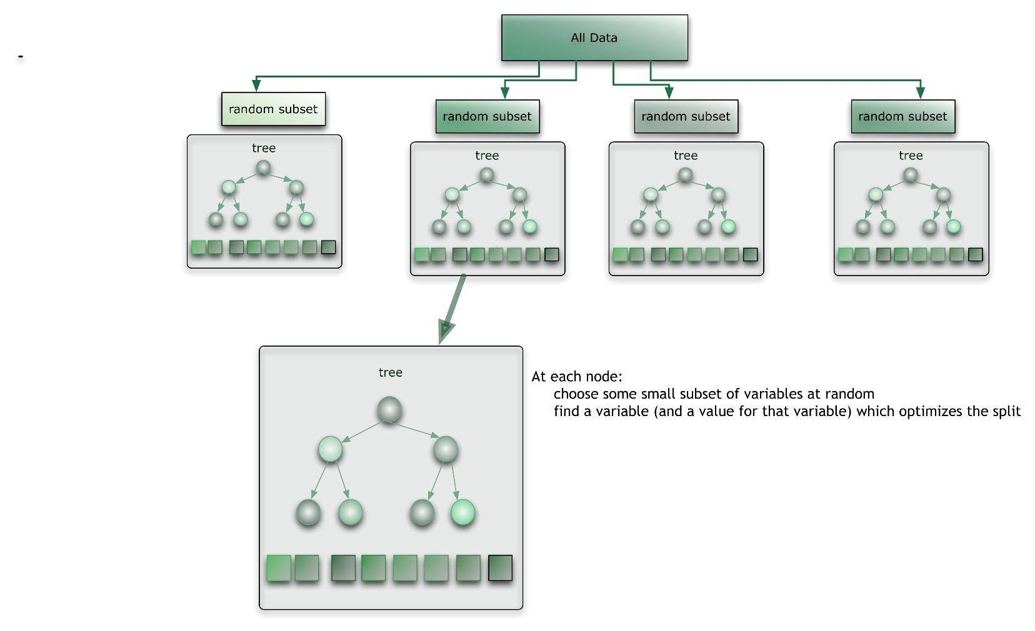
Trees and Forests
The random forest takes this notion to the next level by combining trees with the notion of an ensemble. Thus, in ensemble terms, the trees are weak learners and the random forest is a strong learner.

Slide 33
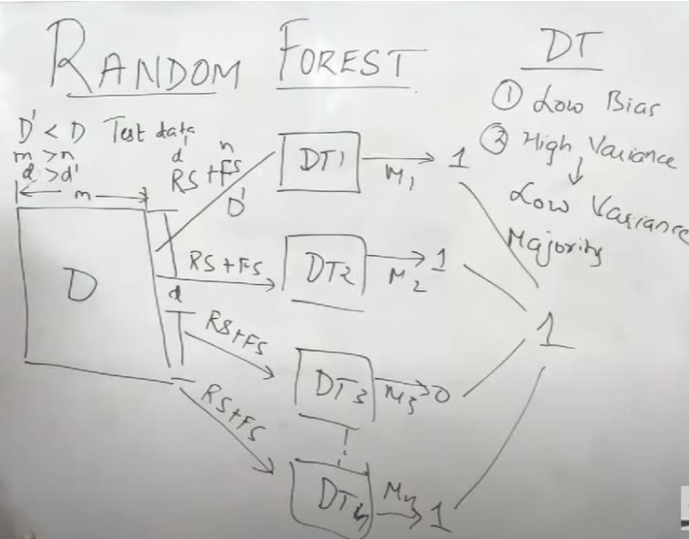
Random Forest
Algorithm

Slide 34
Random Forest
Hyperparameter Tuning
Random Forests, however, are more than just bagged trees and use a number of interesting techniques to further decrease correlation between trees and reduce overfitting.
n_estimators
n_estimators is simply the number of trees. The more uncorrelated trees in our forest, the closer their individual errors get to averaging out.
max_depth
max_depth is the how many splits deep you want each tree to go.max_depth = 50, for example, would limit trees to at most 50 splits down any given branch. This is a better predictor of how overfit the Random Forest is.

Slide 36
Boosting
Boosting is a technique that involves training multiple weak models sequentially. In each iteration, the weak model is trained on the data that was misclassified by the previous models.
The final prediction is a weighted sum of the predictions of all the weak models. Boosting is particularly effective when the individual models are biased or have high error rates.
The main idea behind boosting is to convert weak learners to strong learners in sequential iterations.

Slide 37
Example: boosting
Suppose a candidate has attended five interviews in five different companies. And based on his performance in these five interviews, he wants to rate himself on the skill.
He interviews in all companies one by one and prepares himself for the upcoming interviews by learning the mistakes he made previously.
The outcome is he could rate himself the best after learning from his mistakes and correcting himself. There is a learning rate involved in each step.
Same is the concept of boosting!

Slide 38
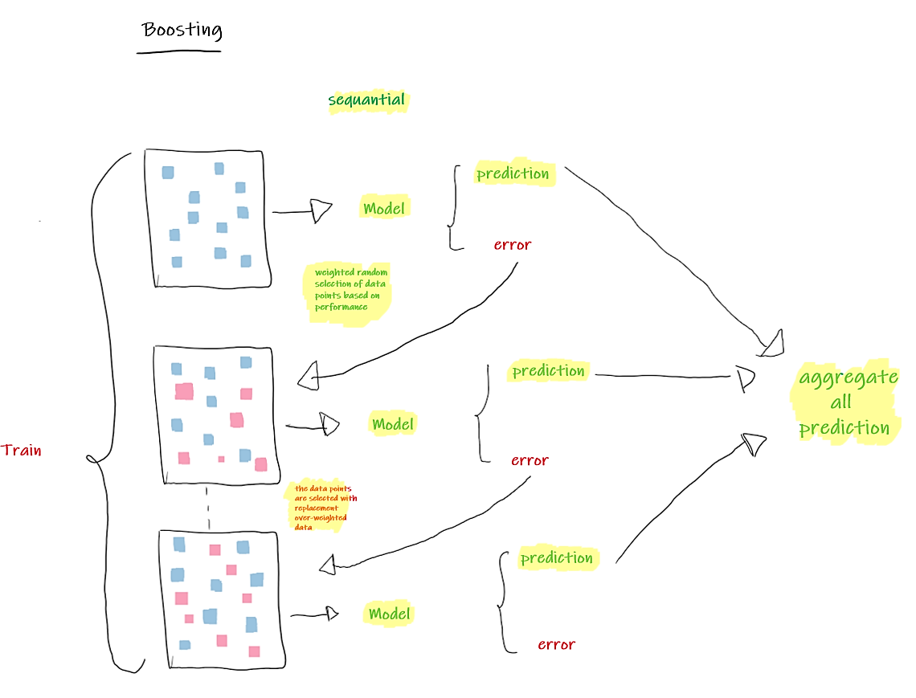
Weights of the misclassified data in the previous model are increased.
Algorithm identify the parameters to focus on to improve its performance.

Slide 39
Types of boosting
Adaptive boosting or AdaBoost
Gradient boosting
Extreme gradient boosting or XGBoost

Slide 40
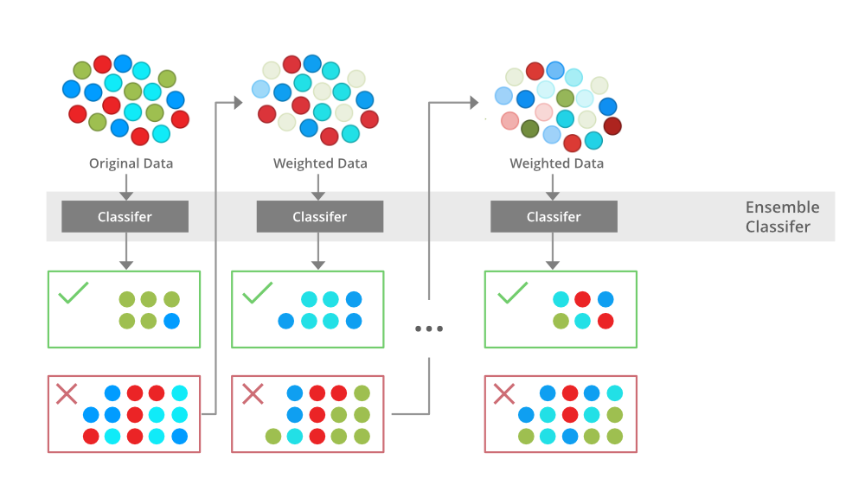
BOOSTING VISUALIZATION

Slide 41
BOOSTING TYPES
Gradient Boosting
ADAboost
XGBoost
CatBoost

Slide 42
Gradient Boosting
Used to minimize the bias error of the model
Aims to improve model accuracy over iterations
Utilizes simple models (weak learners) as building blocks
Sequentially adds predictors to an ensemble with each one correcting for the errors of its predecessor
Can be used for predicting continuous target variable (as a Regressor) as well as categorical target variable (as a Classifier)
When used as a regressor, the cost function is Mean Square Error (MSE) and when it is used as a classifier then the cost function is Log loss.

Slide 43
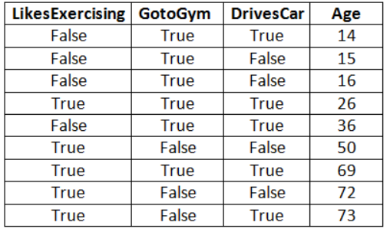
Gradient Boosting (Example)
“Age” target variable
Continuous target variable
Will use Regression
Cost function is Mean Square Error (MSE)
Gradient Boosting Algorithm | How Gradient Boosting Algorithm Works (analyticsvidhya.com)

Slide 44
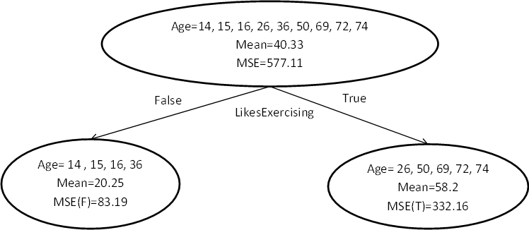
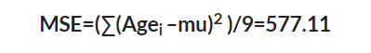
Gradient Boosting (Example)
1st Estimator:
41.33
Root level
Age_{i} = Actual age
Mu = Mean (41.33)
Gradient Boosting Algorithm | How Gradient Boosting Algorithm Works (analyticsvidhya.com)

Slide 45
Gradient Boosting (Example)
Root level consists of all records
Predicted age of this level is the mean of entire “Age” column (41.33)
Gradient Boosting Algorithm | How Gradient Boosting Algorithm Works (analyticsvidhya.com)

Slide 46
Gradient Boosting (Example)
The cost function is MSE
Goal is to reduce it
Gradient Boosting Algorithm | How Gradient Boosting Algorithm Works (analyticsvidhya.com)

Slide 47
Gradient Boosting (Example)
Will create a decision stump with one of the independent variables
Lets take “LikesExercising”
“True” and “False” records will go to different child nodes
Gradient Boosting Algorithm | How Gradient Boosting Algorithm Works (analyticsvidhya.com)

Slide 48
Gradient Boosting (Example)
Level-1
Gradient Boosting Algorithm | How Gradient Boosting Algorithm Works (analyticsvidhya.com)

Slide 49
Gradient Boosting (Example)
Level-1
The mean and MSE will be calculated now in the same way for Level 1!
Gradient Boosting Algorithm | How Gradient Boosting Algorithm Works (analyticsvidhya.com)

Slide 50
Gradient Boosting (Example)
Level-1
Total MSE of level 1 = (83.19+332.16) = 415.35
The cost function MSE is reduced in level 1
Gradient Boosting Algorithm | How Gradient Boosting Algorithm Works (analyticsvidhya.com)

Slide 51
Gradient Boosting (Example)
Now lets find the residues!
Residue = Age_{i} – mean
Now we’ll take “GotoGym” to again make a decision stamp
The process will be same as before
Residues = -6.25, -5.25, -4.25, -32.2, 15.75, -8.2, 10.8, 13.8, 15.8
Gradient Boosting Algorithm | How Gradient Boosting Algorithm Works (analyticsvidhya.com)

Slide 52
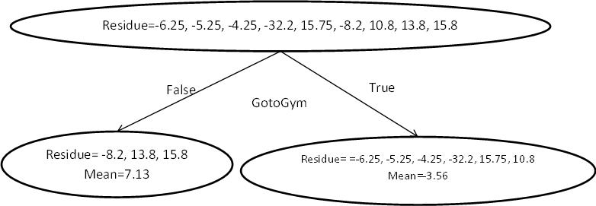
Gradient Boosting (Example)
Residues = -6.25, -5.25, -4.25, -32.2, 15.75, -8.2, 10.8, 13.8, 15.8
Gradient Boosting Algorithm | How Gradient Boosting Algorithm Works (analyticsvidhya.com)

Slide 53
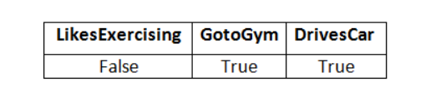
Gradient Boosting (Example)
Now lets predict an “Age”
LikesExercising = False, so the predicted age is 20.25 as per the figure
Gradient Boosting Algorithm | How Gradient Boosting Algorithm Works (analyticsvidhya.com)

Slide 54
Gradient Boosting (Example)
Now lets predict an “Age”
GotoGym = True, so the predicted age is -3.56 as per the figure
Gradient Boosting Algorithm | How Gradient Boosting Algorithm Works (analyticsvidhya.com)

Slide 55
Gradient Boosting (Example)
Now lets predict an “Age”
Then both are added {20.25+(-3.56)} = 16.69
Final Age prediction is now 16.69 by this model!
Gradient Boosting Algorithm | How Gradient Boosting Algorithm Works (analyticsvidhya.com)

Slide 56
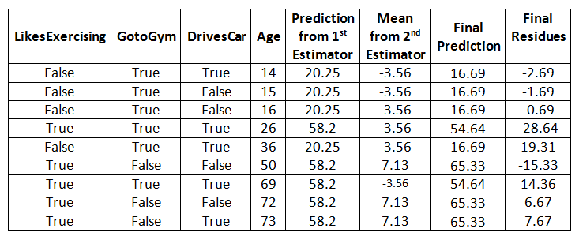
Gradient Boosting (Example)
Now lets predict all the “Age”
Gradient Boosting Algorithm | How Gradient Boosting Algorithm Works (analyticsvidhya.com)

Slide 57
Gradient Boosting (Example)
Let us now find out the Final MSE for above all 9 records
MSE= ((-2.69)2 +(-1.69)2 + (-0.69)2 +(-28.64)2 +(19.31)2 +(-15.33)2 + (14.36)2 +(6.67)2 +(7.67)2 )/9 = 194.2478
Gradient Boosting Algorithm | How Gradient Boosting Algorithm Works (analyticsvidhya.com)

Slide 58
Gradient Boosting (Example)
MSE form level 0 was 577.11
Final MSE 194.2478
Final MSE is much better than the MSE of the root node of the 1st Estimator!
Gradient Boosting Algorithm | How Gradient Boosting Algorithm Works (analyticsvidhya.com)

Slide 59
https://www.youtube.com/watch?v=RzmJ1qaCZ4w

Slide 60
What is AdaBoost?
ADABOOST
AdaBoost, short for Adaptive Boosting, is an ensemble machine learning algorithm that can be used in a wide variety of classification and regression tasks. It is a supervised learning algorithm that is used to classify data by combining multiple weak or base learners (e.g., decision trees) into a strong learner.

Slide 61
STACKING
Stacking is Harnessing the collective intelligence of diverse models to boost prediction accuracy and robustness through an adaptive meta-classifier
21-05-2023

Slide 62
Stacking
Stacking is a meta-learning technique that combines multiple base models of different types, such as decision trees, neural networks, and support vector machines, to create a more powerful meta-model.
the predictions of the base models are used as input to a higher-level model, called a meta-model, which learns how to combine the base model predictions to make the final prediction.
The idea behind stacking is to leverage the strengths of different base models to improve overall predictive performance.

Slide 63
Stacking
Original data: This data is divided into n-folds and is also considered test data or training data.
Base models: These models are also referred to as level-0 models. These models use training data and provide compiled predictions (level-0) as an output.
Level-0 Predictions: Each base model is triggered on some training data and provides different predictions, which are known as level-0 predictions.

Slide 64
Stacking
Meta Model: The architecture of the stacking model consists of one meta-model, which helps to best combine the predictions of the base models. The meta-model is also known as the level-1 model.
Level-1 Prediction: The meta-model learns how to best combine the predictions of the base models.
Trained on different predictions made by individual base models, i.e., data not used to train the base models are fed to the meta-model,
Predictions are made, and these predictions, along with the expected outputs, provide the input and output pairs of the training dataset used to fit the meta-model.

Slide 65
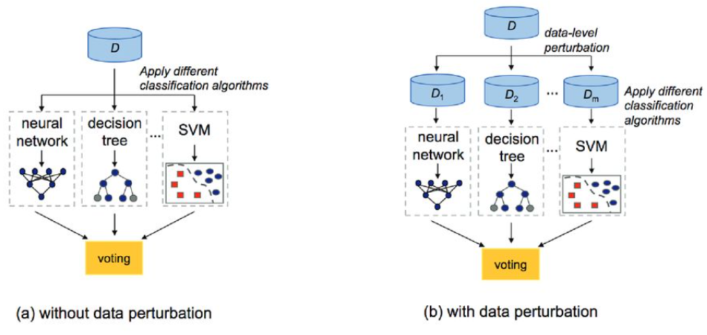
Stacking model example
Notes:
Perturbation

Slide 66
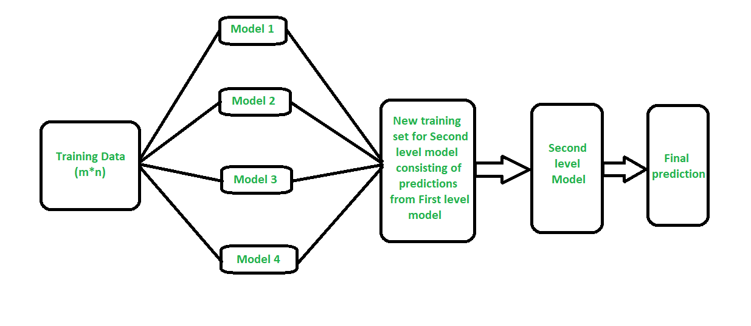
PROCESS OF STACKING
21-05-2023

Slide 67
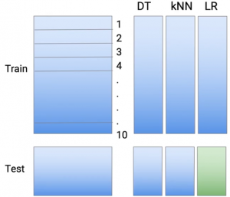
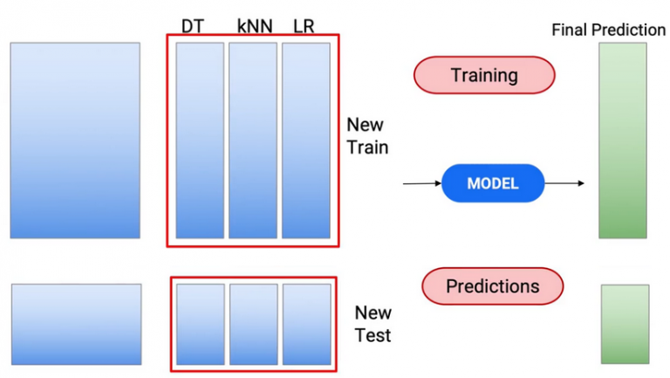
VARIANTS OF STACKING
Use given features along with the new predictions​
21-05-2023

Slide 68
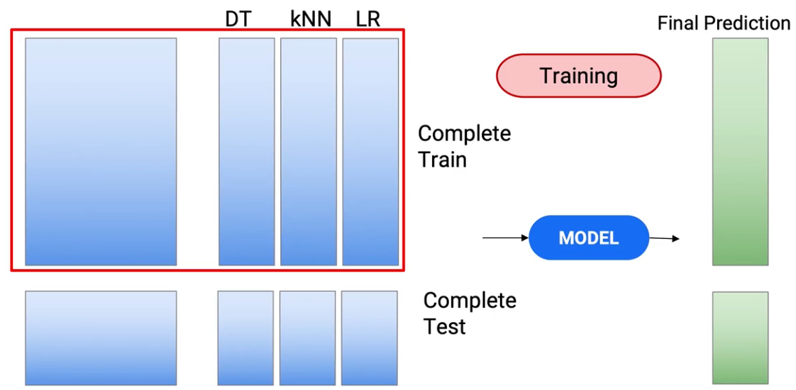
VARIANTS OF STACKING
21-05-2023

Slide 69
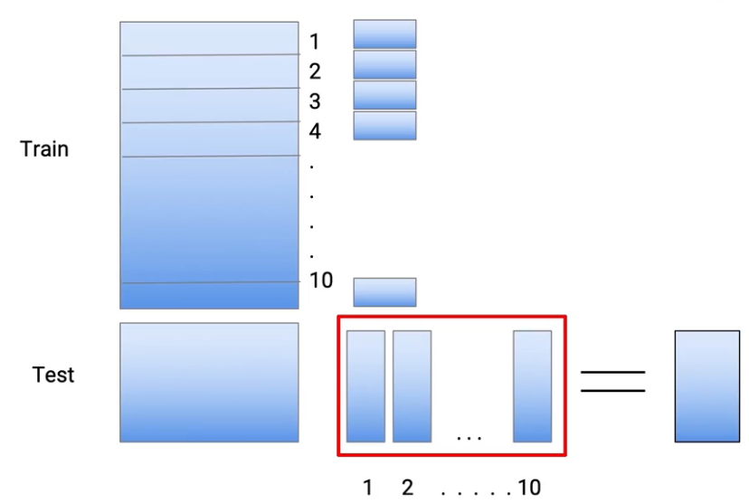
VARIANTS OF STACKING
Generate Mulitple predictions for test and aggregate them
21-05-2023

Slide 70
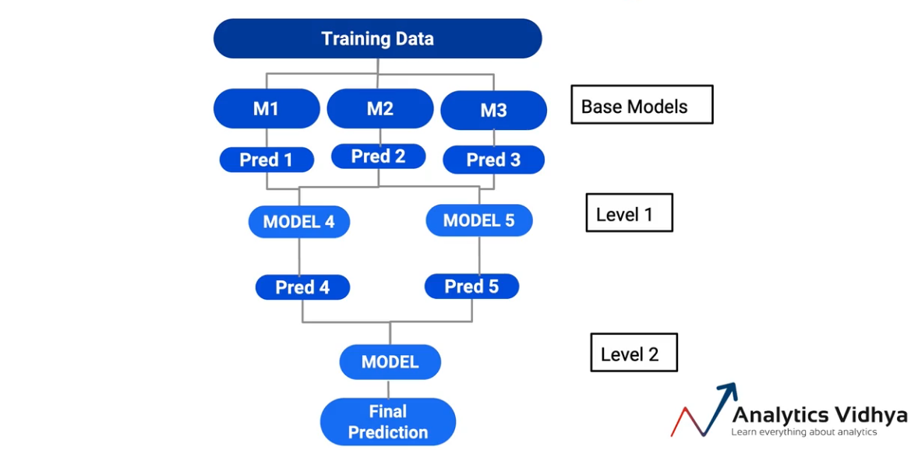
VARIANTS OF STACKING
Increase the number of levels for stacking models
21-05-2023

Slide 71
Summary: bagging, boosting, stacking
Bagging reduces overfitting and improves stability, boosting adapts to complex data and reduces bias, and stacking combines the strengths of different models to improve accuracy.
However, each technique has its own pros and cons, and the choice of which technique to use depends on the specific problem and performance requirements.

Slide 72
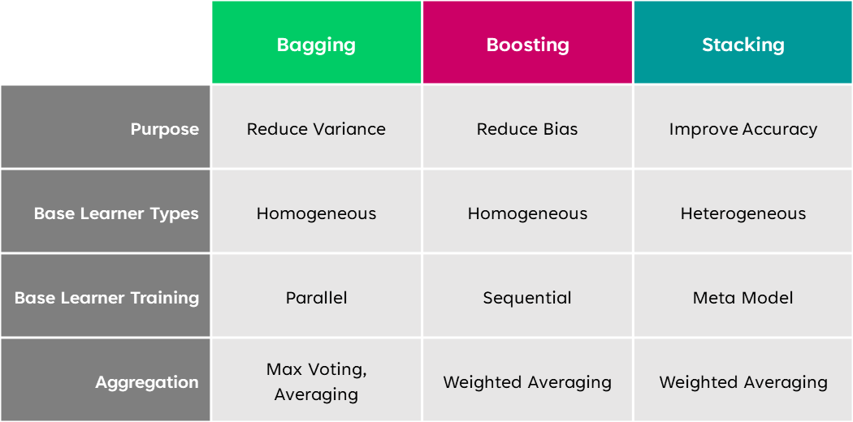
BOOSTING
Wisdom of Crowd
2
9/22/2023
72

Slide 73
Comparison
Technique | Description | Pros | Cons
Bagging | Bootstrap Aggregating involves creating multiple versions of a single base model and averaging their predictions. | Reduces overfitting, improves stability, and robustness. | Requires more computational resources and time.
Boosting | A technique that creates a sequence of models where each model learns to correct the errors of the previous model. | Improves accuracy, reduces bias, and adapts to complex data. | Prone to overfitting, sensitive to noisy data, and requires careful parameter tuning.
Stacking | A meta-learning technique that combines predictions from multiple base models of different types using a higher-level meta-model. | Combines strengths of different models, improves accuracy, and handles non-linear relationships. | Can be computationally expensive, requires careful model selection, and is prone to overfitting if not done properly.

Slide 74
Application In Real Life
Ensemble learning is a fairly common strategy in deep learning and has been applied to tackle a myriad of problems. It has helped tackle complex pattern recognition tasks that require computers to learn high-level semantic information from digital images or videos, like object detection, where bounding boxes need to be formed around the objects of interest and image classification.

Slide 75

Application In Real Life
Disease detection
Classification and localization of diseases for simplistic and fast prognosis have been aided by Ensemble learning, like in cardiovascular disease detection from X-Ray and CT scans.
AI chest X-ray annotation analysis

Slide 76
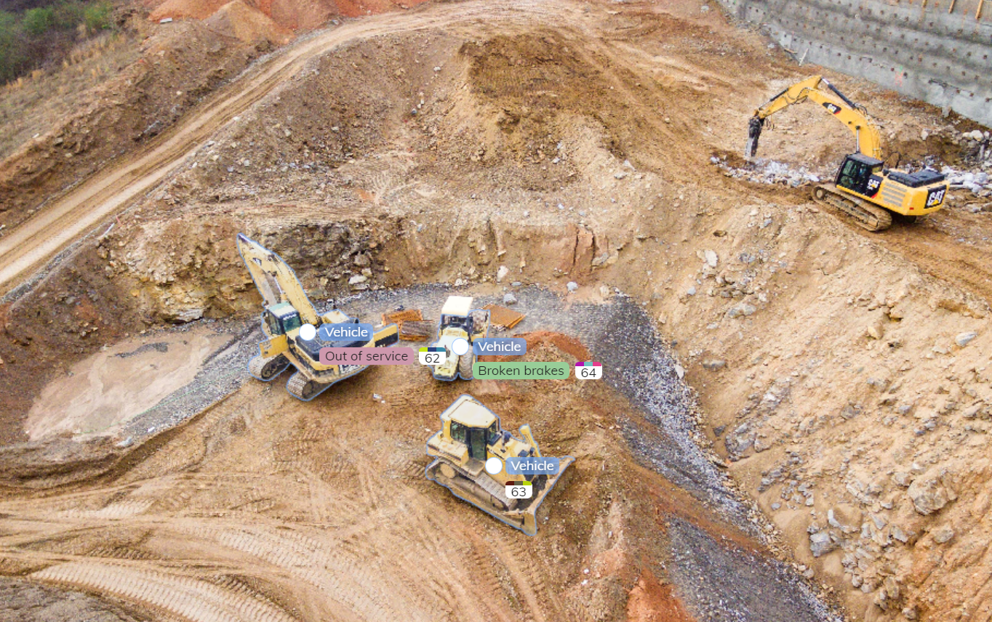
Application In Real Life
Remote Sensing
Monitoring of physical characteristics of a target area without coming in physical contact, called Remote Sensing, is a difficult task since the data acquired by different sensors have varying resolutions leading to incoherence in data distribution.
Tasks like Landslide Detection and Scene Classification have also been accomplished with the help of Ensemble Learning.
Construction land cover mapping with annotated vehicles

Slide 77

Application In Real Life
Fraud Detection
Detection of digital fraud is an important and challenging task since very minute precision is required to automate the process. Ensemble Learning has proved its efficacy in detecting Credit Card Fraud and Impression Fraud.
Implementing a Fraud Detection System

Slide 78
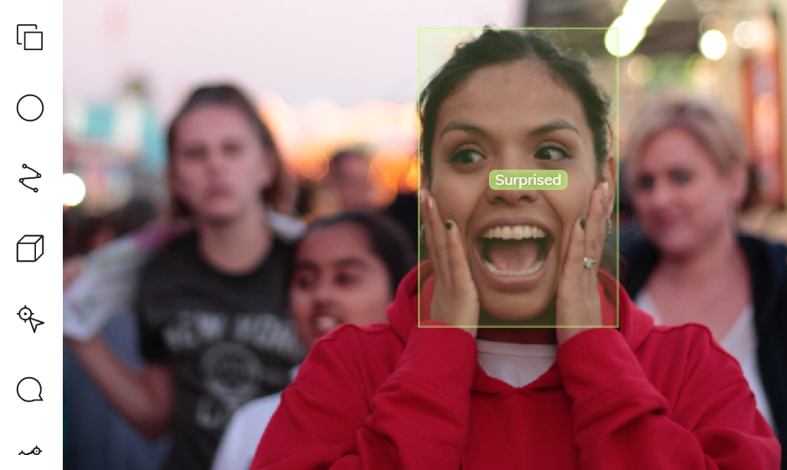
Application In Real Life
Speech emotion recognition
Ensemble Learning is also applied in speech emotion recognition, especially in the case of multi-lingual environments. The technique allows for the combining of all classifiers’ effect instead of choosing one classifier and compromising certain language corpus’s accuracy.
Emotion recognition using V7 bounding box

Slide 79
Advantages of ENSEMBLE
Reduction of Bias
Versatility
Improvement of accuracy
Improves Robustness
Gives stable consistent results

Slide 80
CHALLENGES
Main Challenge for Developing Ensemble Models?
The main challenge is not to obtain highly accurate base models, but rather to obtain base models which make different kinds of errors. For example, if ensembles are used for classification, high accuracies can be accomplished if different base models misclassify different training examples, even if the base classifier accuracy is low.

Slide 81

CONCLUSION
So, in summary, ensemble classifiers are like the Avengers of the machine learning world. They bring together a diverse group of models, each with its unique superpower, to save the day and make our predictions more accurate. Just like Iron Man, Captain America, and Thor are stronger together, our decision trees, support vector machines, and neural networks are a formidable team when combined.

Slide 82
REFERENCES
Stacking : https://www.analyticsvidhya.com/blog/2021/03/advanced-ensemble-learning-technique-stacking-and-its-variants/
AdaBoost : https://www.youtube.com/watch?v=9CPsYsB4OLI&t=1s
Challenges : https://www.geeksforgeeks.org/ensemble-classifier-data-mining/
Rainforest Algorithm : https://youtu.be/nxFG5xdpDto?si=5isYUmxSjHbAKnj2
Applications : https://www.v7labs.com/blog/ensemble-learning#h4

Slide 83
THANK YOU

Slide 84

ANY QUESTIONS?

